Slide 1
A Mehman of Texts
Building background knowledge for The Kite Runner

Slide 2
Look at the photographs which follow
Answer each question on your tracking sheet under Article 2: Afghanistan in photos

Slide 3
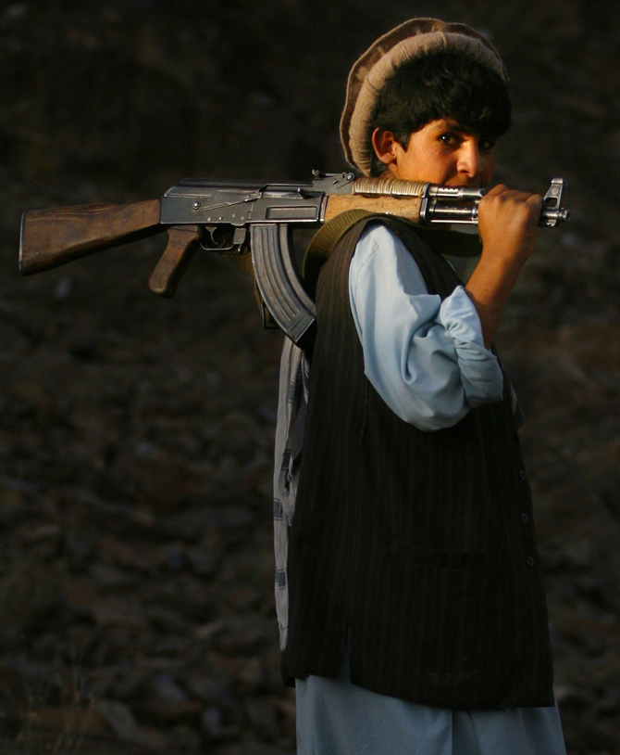
Why is this boy carrying a gun?

Slide 4
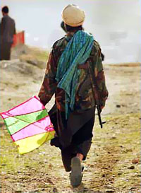
Explain the juxtaposition of the rifle and the kite from what you have learned about Afghanistan society

Slide 5
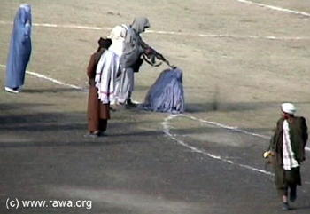
What is happening here? Explain from what you have learned about Afghanistan.

Slide 6
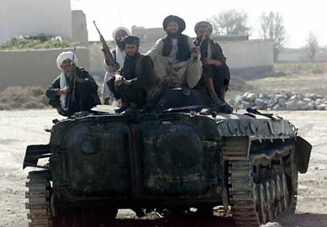
Who are these guys? Based on what you have learned how do the locals feel about them?

Slide 7
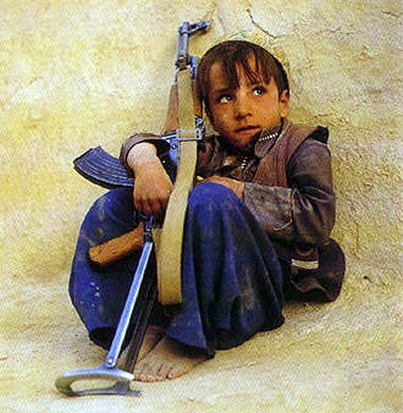
Discuss what you feel and see here.

Slide 8
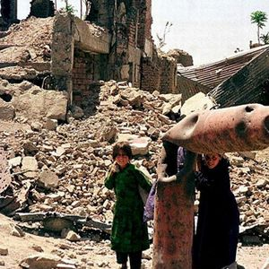
Based on this photograph and what you have read and seen so far, how are these children’s lives affected by the war? How are their lives different from yours?

Slide 9
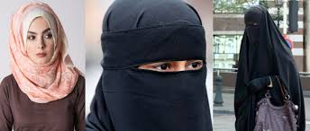
Why are the two women on the right covering their faces?

